Slide 1



KNN Classifier Accelerator
Backend Design Review
Students: Roy Rapaport, Dan Katz
Supervisor: Goel Samuel

Slide 2
Outline
KNN Algorithm
Project’s requirements and specifications
Progress review: Stages covered
Top Level Architecture
Back-end stages
Milestones Ahead

Slide 3
KNN Algorithm- Introduction
Definition: The K-nearest neighbors (KNN) is a non-parametric, supervised algorithm used for classification and regression tasks
Core Idea: KNN uses proximity to make classification or predictions about the grouping of an individual data point

Slide 4
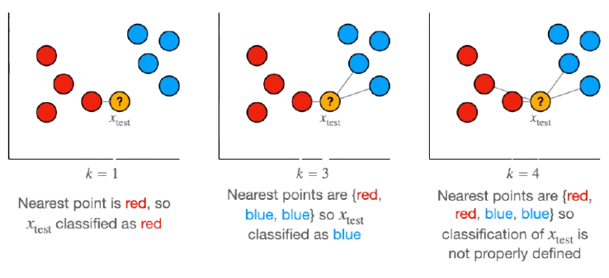
KNN Algorithm- Example
The example was taken from: https://towardsdatascience.com/

Slide 5
KNN Algorithm- Example
The example was taken from: https://towardsdatascience.com/

Slide 6
KNN Algorithm- Example
The example was taken from: https://towardsdatascience.com/

Slide 7
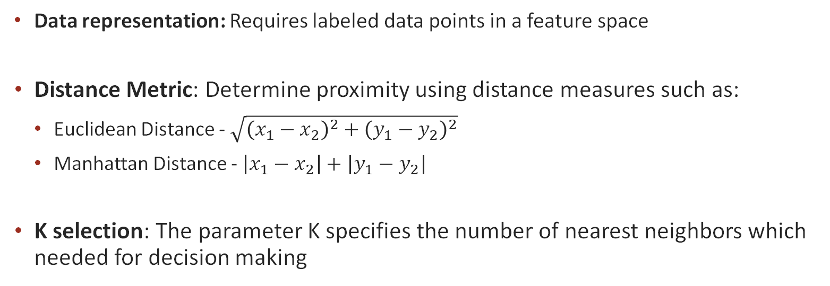
KNN Algorithm- How it works?
Data representation: Requires labeled data points in a feature space
Distance Metric: Determine proximity using distance measures such as:
Euclidean Distance - $\sqrt{{\left(x_{1}−x_{2}\right)}^{2}+{\left(y_{1}−y_{2}\right)}^{2}}$
Manhattan Distance - $\left|x_{1}−x_{2}\right|+|y_{1}−y_{2}|$
K selection: The parameter K specifies the number of nearest neighbors which needed for decision making

Slide 8
KNN Algorithm- Steps
Data preparation: Store all training data in memory. In certain cases, we normalize or scale the training data to avoid biases from differing feature magnitudes
Compute distance: For each new test point, calculate the distance to all training points
Neighbor selection: Identify the K closest training points based on the chosen distance metric
Predict output:
Classification: assign the class based on majority.
Regression: assign the average value of the K-nearest neighbors

Slide 9
Project’s Requirements and Specifications
KNN Algorithm:
K: 5
Number of groups: 2
Distance Metric: Manhattan Distance
Number of Train points: 128
Data points range: [0,1023]

Slide 10
Project’s Requirements and Specifications
Technology process: TSMC 65 nm
Maximum area: 1.0x1.0 sq mm
Maximum number of I/Os: 48
Clock frequency: 100 Mhz
Performance efficiency

Slide 11
Progress Review: Stages Covered
Frontend
Backend
Software Implementation
Synthesis with Scan Chain Insertion
Routing
Architecture
Gate Level Simulation & LEC
Power Analysis & IR Drop
RTL Implementation
Floorplan & Placement
Timing Signoff
Simulations
Clock Tree Synthesis
Physical Design Verification

Slide 12
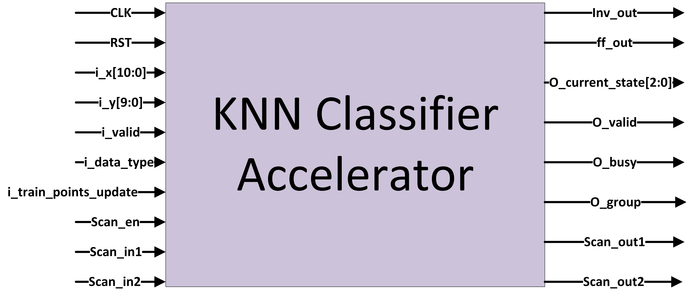
I/O Diagram
29 Inputs pins, 10 Outputs pins
(+ 9 I/O for the Power Supply)
i_x Data Packet
Group
X Value
0 | 1 | 0 | 1 | 1 | 0 | 1 | 1 | 0 | 0 | 1

Slide 13
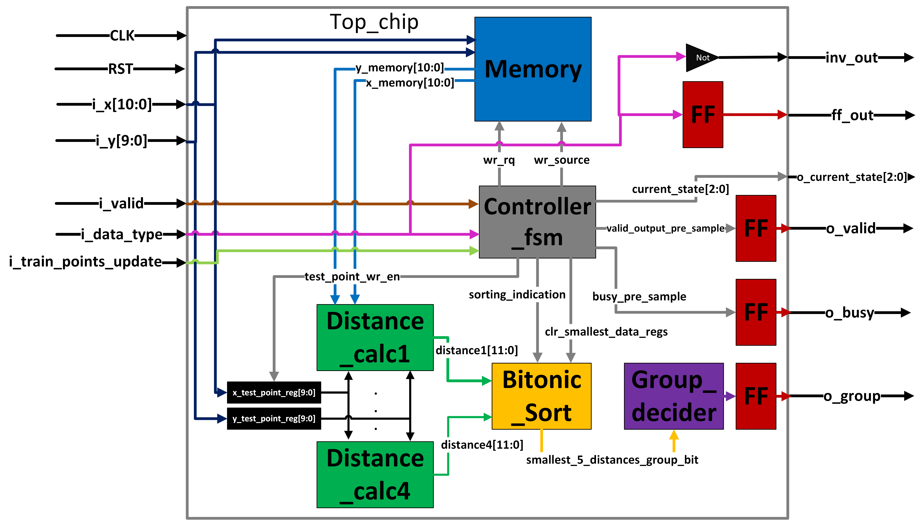

Top Level Architecture
Smallest_5_distances_group_bit

Slide 14
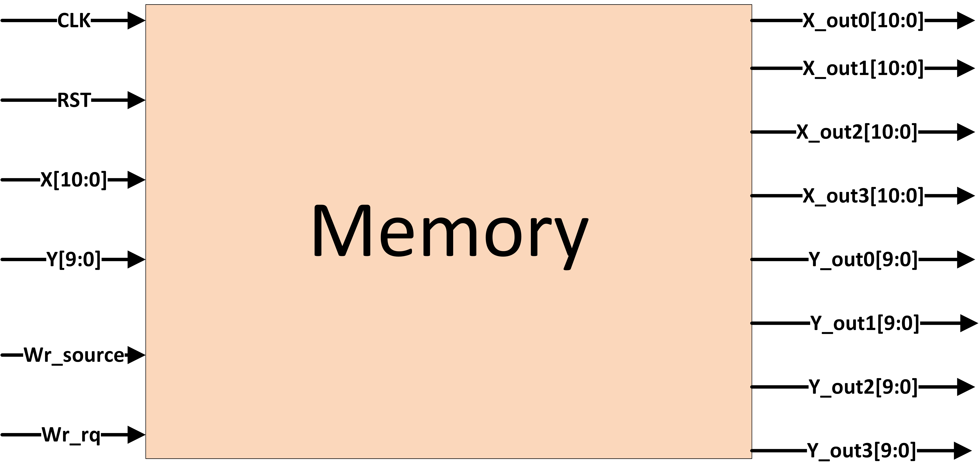
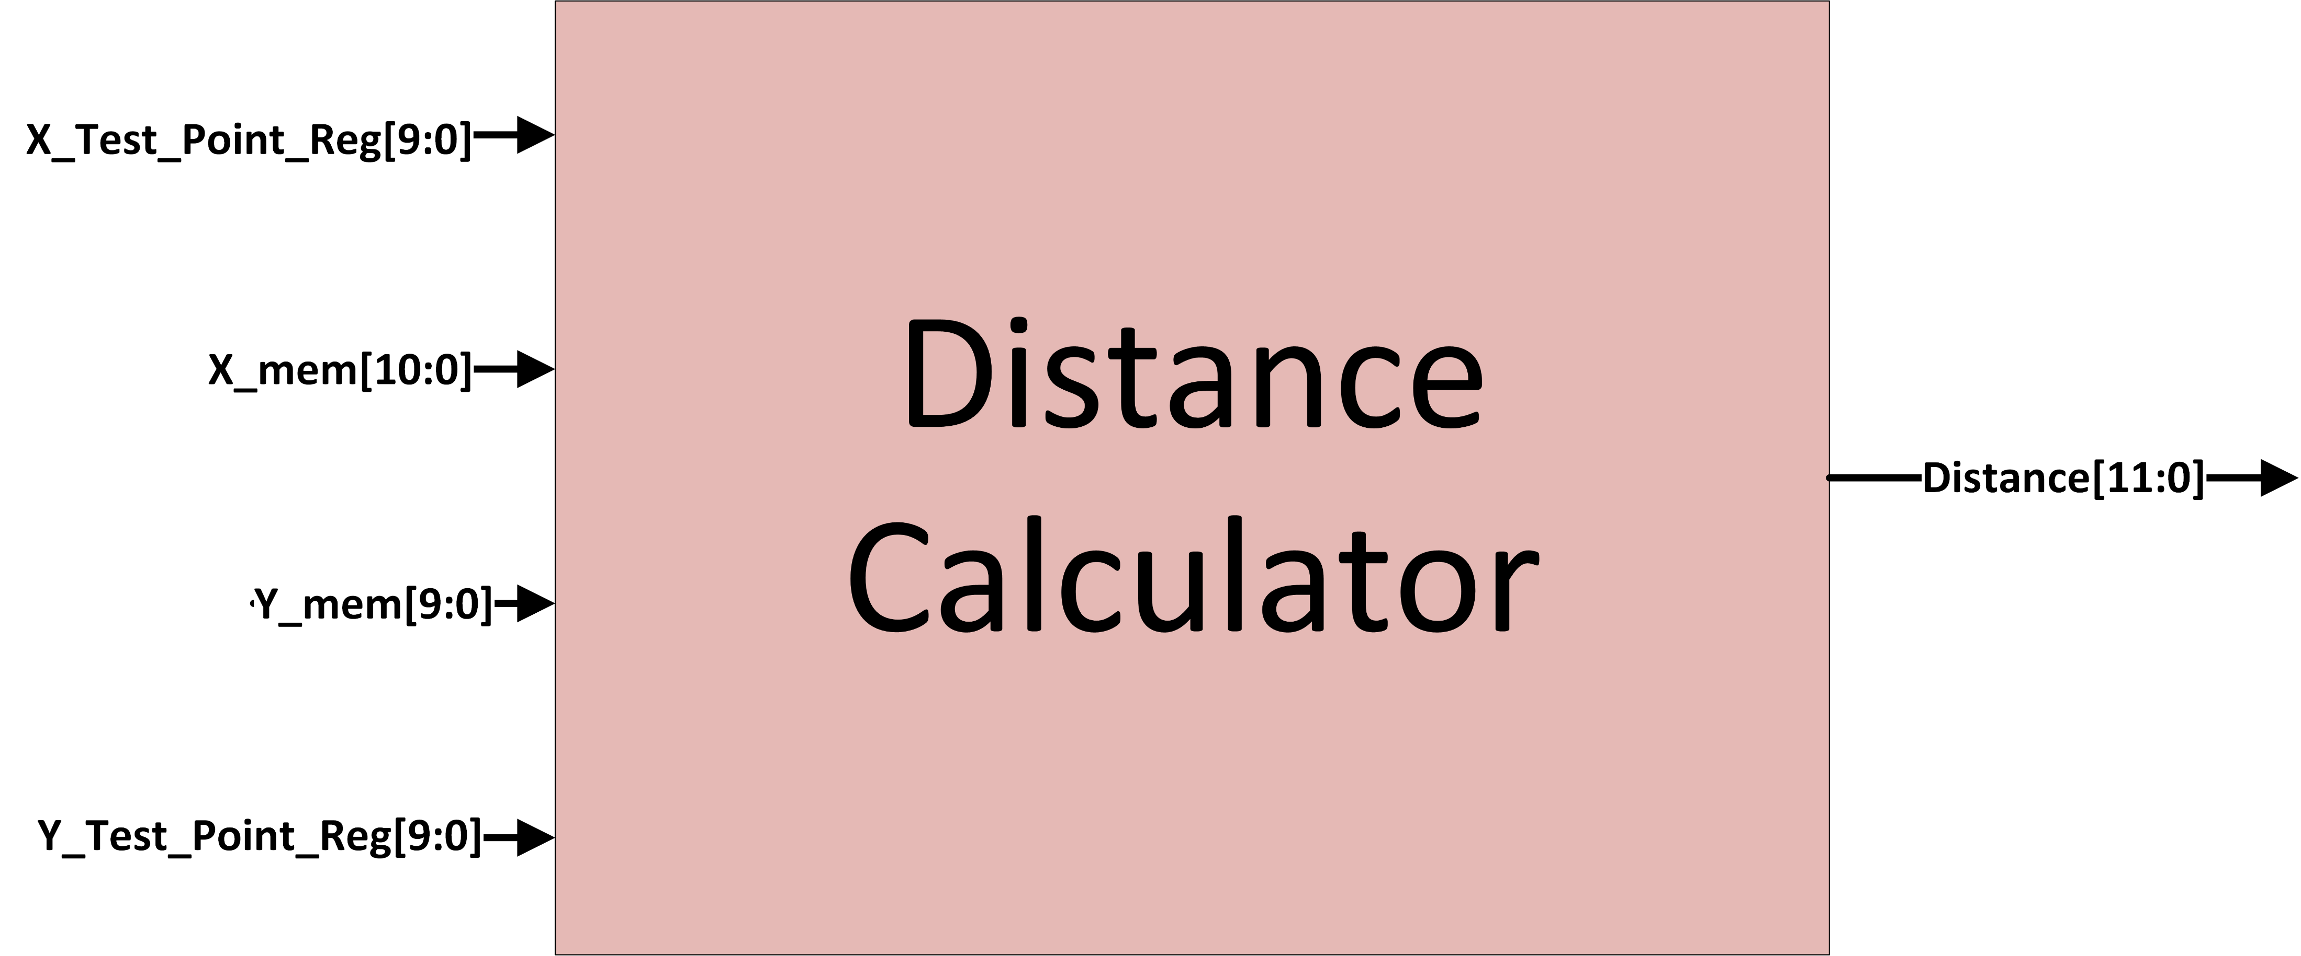
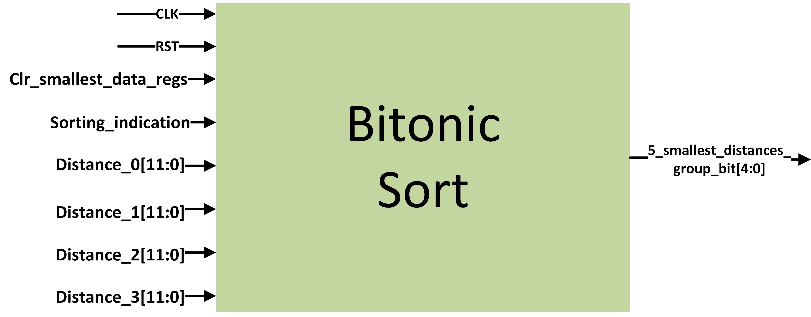
Top Level Architecture

Slide 15
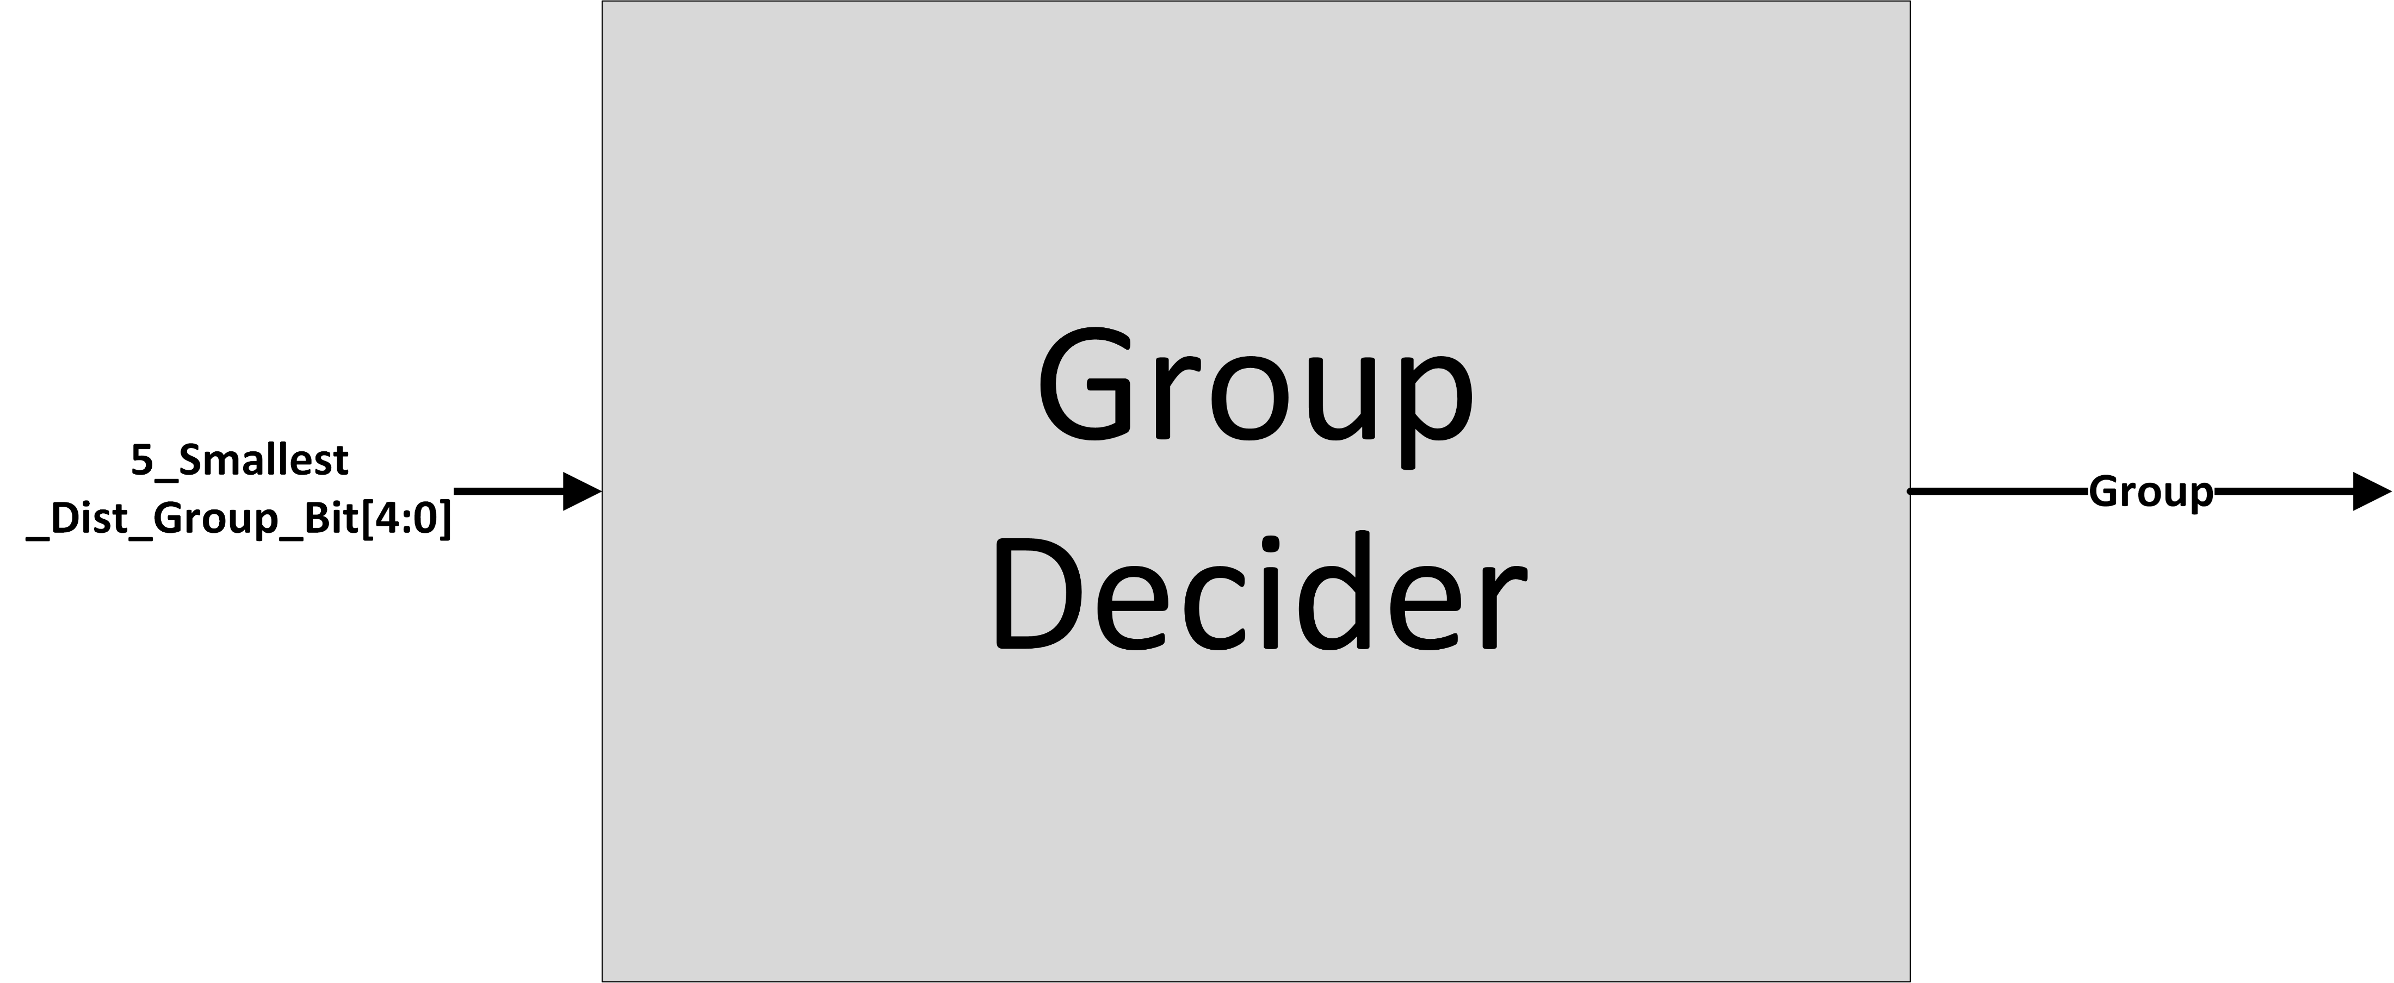
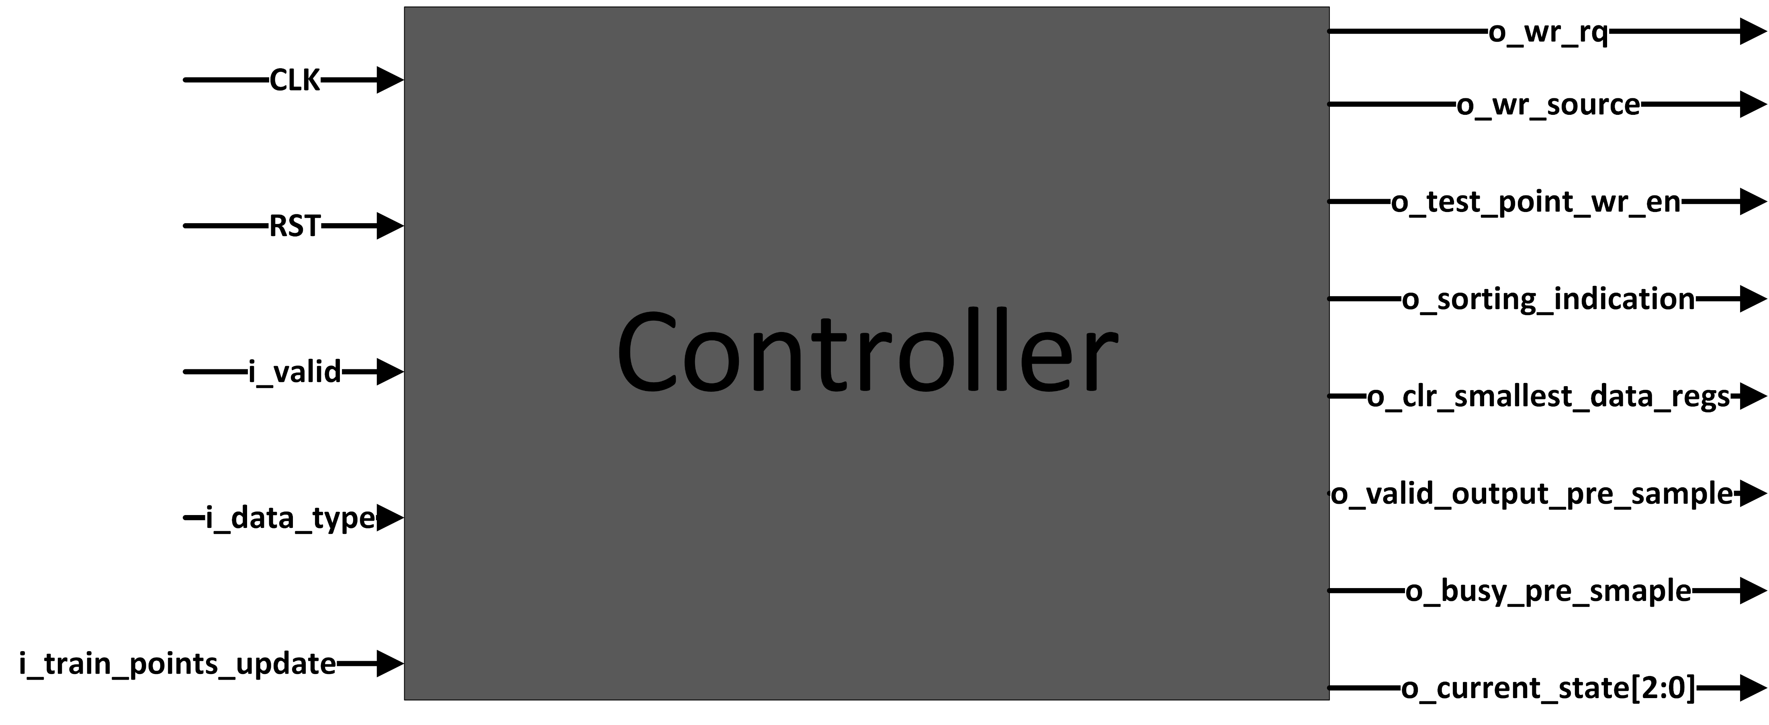
Top Level Architecture

Slide 16
Backend design tools
Synthesis – Design Compiler (Synopsys)
Gate Level Simulation – VCS (Synopsys)
Logical Equivalence Check (LEC) – Conformal (Cadence)
Physical Design – Innovus (Cadence)
Timing Signoff – PrimeTime (Synopsys)
Physical Design Verification – Virtuoso (Cadence)

Slide 17
Synthesis
Translating RTL code into a gate-level netlist using standard cell libraries.
Applies algorithms to minimize area and power while preserving the intended functionality.
Scan chains are inserted to improve testability.
Clock gating is inserted for power reduction.
In our KNN Classifier Accelerator:
Ultra Compile
2 Scan chains
No Clock gating

Slide 18
Logical Equivalence Checking -lec
Case 1:
Used compile (no scan chains, no clock gating) : Netlist vs. RTL comparison using LEC: Passed
Case 2:
Used ultra compile (no scan chains, no clock gating) :Netlist vs. RTL comparison using LEC: Passed
Case 3:
Used ultra compile with 2 scan chains, no clock gating: Netlist vs. RTL comparison using LEC: Passed
Case 4:
Used compile with 2 scan chains and clock gating: Netlist vs. RTL comparison using LEC: Failed.
✅ Selected Configuration: Case 3 : Validated with Gate-Level Simulation: Passed

Slide 19
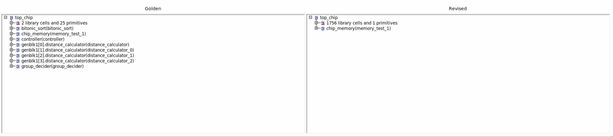
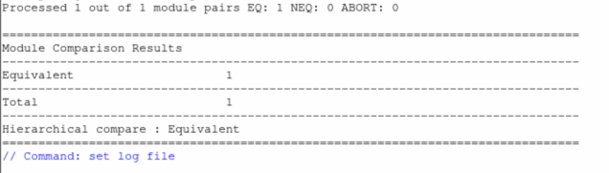
Logical Equivalence Checking -lec

Slide 20
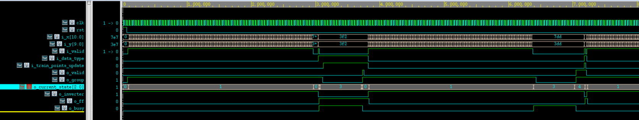
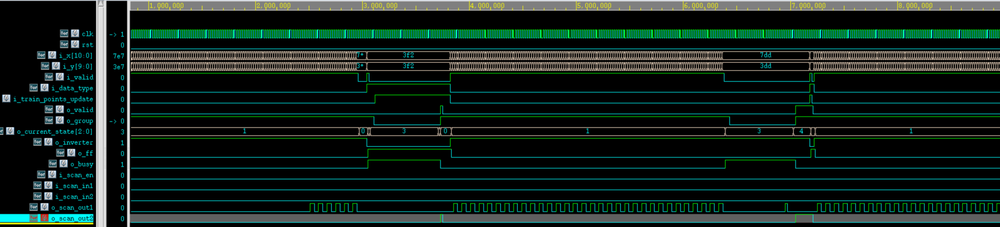
Gate level simulation
RTL:
Synthesis:
Gate Level Simulation – RTL Vs. Synthesis with scan chains + pads

Slide 21
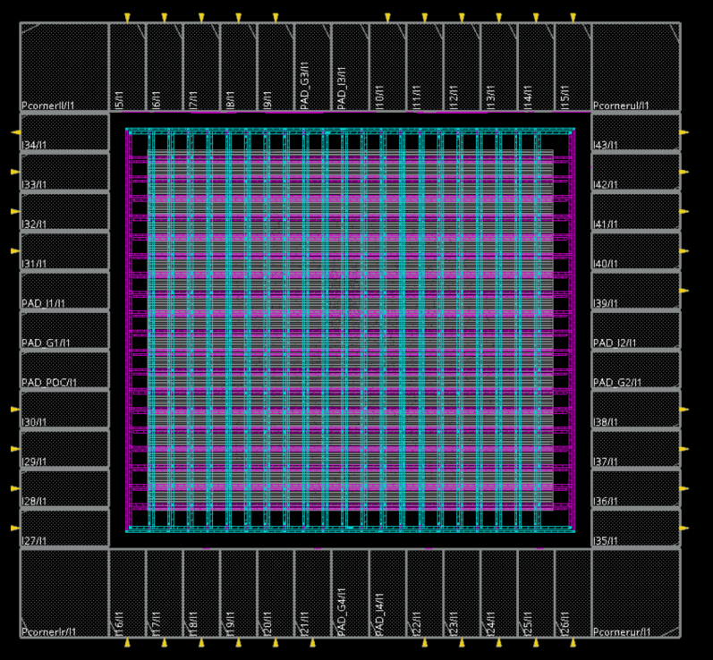
Physical design - floorplan
Core
VSS
CLK
Core VDD
Die creation & chip size determination: Die size: Width: 890 [um] Height: 830 [um]
Power & I/O PADs positioning: Core to IO Boundary: 52 [um]
Power Ring & Grid Generation.
I/Os VDD
I/Os VDD
I/Os VSS
I/Os VSS
Core
VDD
Core
VSS

Slide 22
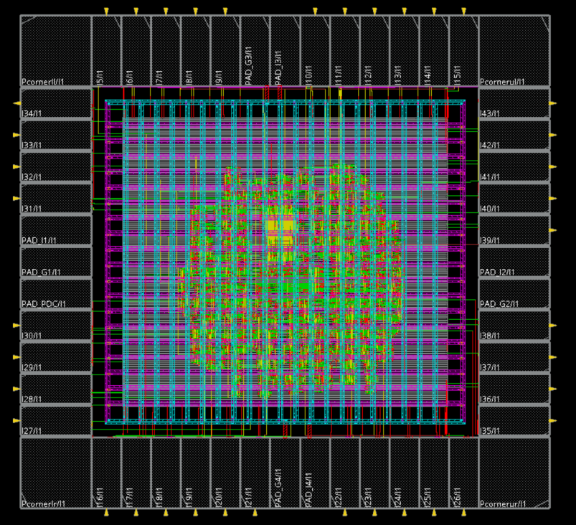
Physical design - placement
Standard cells placement, while optimizing:
Timing
Wire length
Area
Power
Maximum Density: 0.35

Slide 23
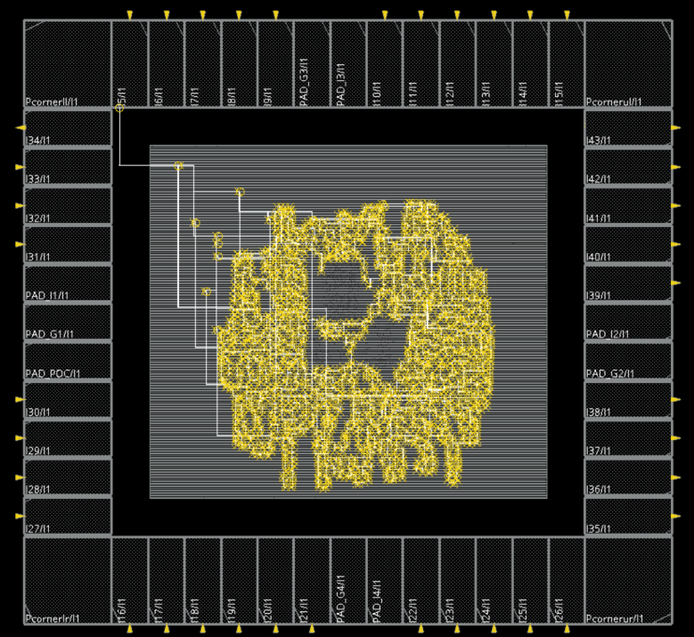
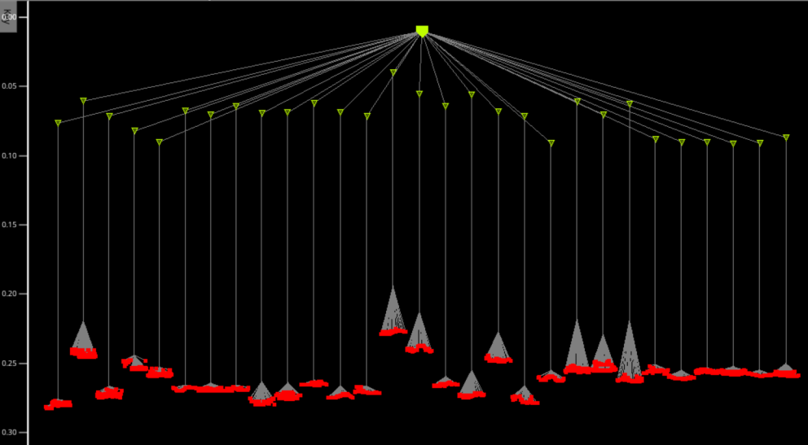
Physical design – clock tree synthesis (cts)
Critical process that aims to minimize skew, insertion delay
The process ensure that the clock signal reaches all the FF in the design nearly at the same time
Delay : 220-280ps
Skew: 60ps

Slide 24
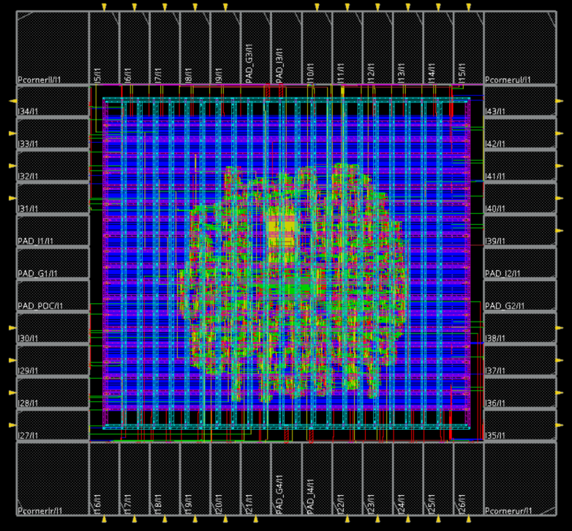
Physical design – routing
This process employs metal layers to physically connect signal pins
Performs subsequent optimizations to connect standard cells, macros, and I/O pins
Creates electrical pathways with metals and vias based on the logical connections from the netlist

Slide 25
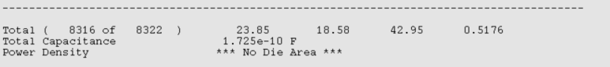
Physical design – power analysis
Static Power Analysis result using innovus:
FastRC Total Power Consumption: 42.95 [mW]
SlowRC Total Power Consumption: 29.84 [mW]
Dynamic Power Analysis result using innovus:
Dynamic peak power consumption was 0.1396 W — the peak usage in both FastRC and SlowRC scenarios.

Slide 26
Physical design –rail analysis
IR Drop Analysis: Rail analysis checks voltage drops in the power grid to ensure they stay within safe limits, avoiding failures caused by low voltage.
IR Drop Limit: Must be below 7% of 1.2 V, i.e., should not exceed 84 mV.
The VDD IR drop: 13.28mV
The VSS IR drop: 12.87mV
For the IR Drop Analysis we used:
Input activity: 0.2
FF activity: 0.4
Freq: 100 [MHz]

Slide 27
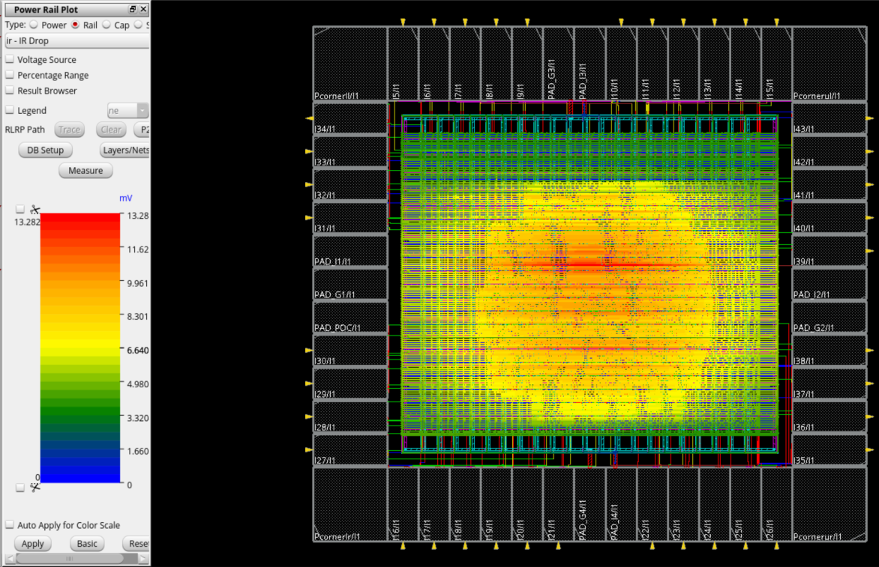
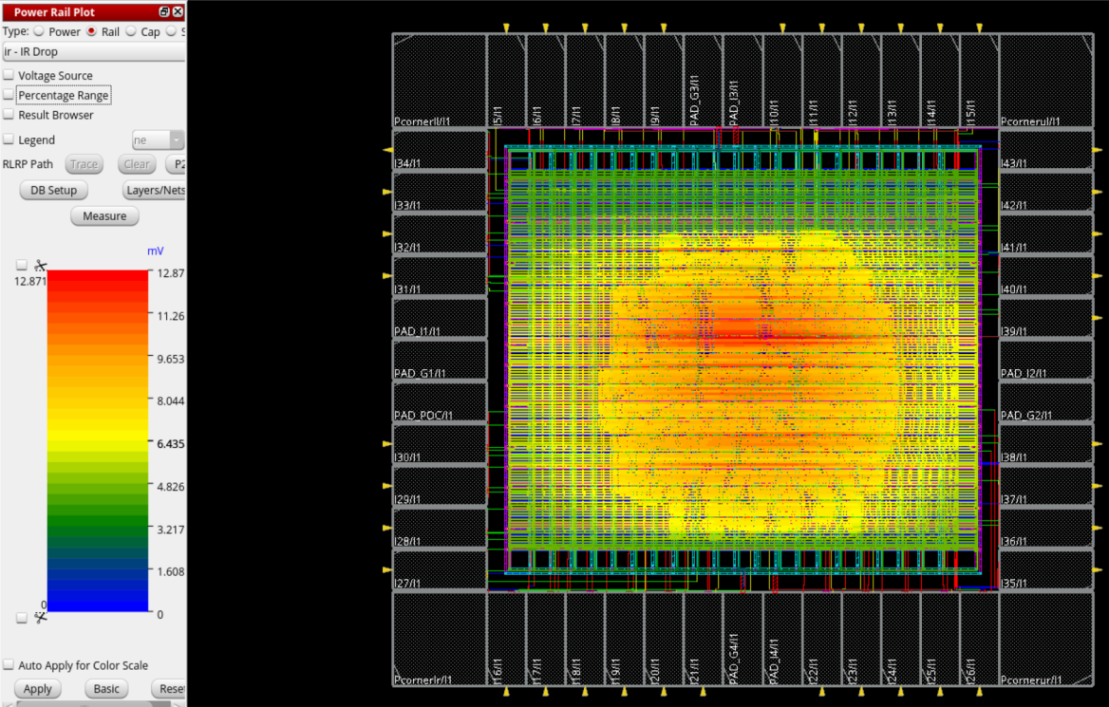
Physical design –rail analysis
VDD:
VSS:

Slide 28
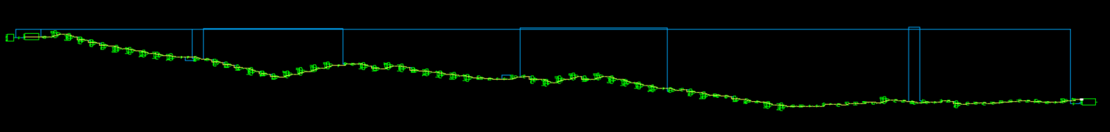
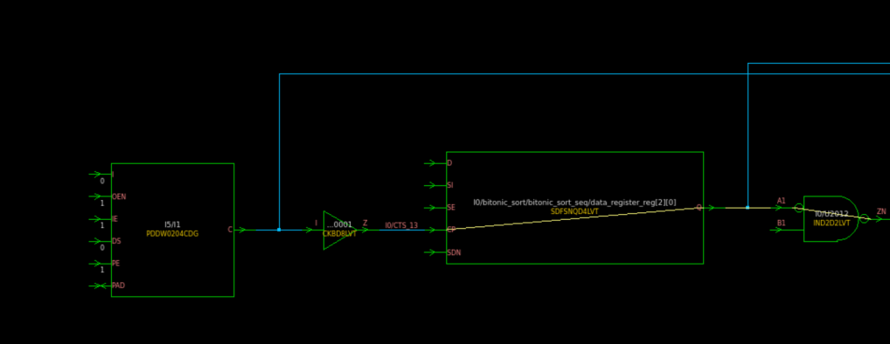
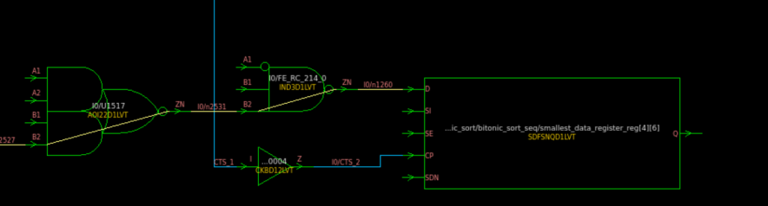
Physical design – Timing SIGNOFF
Perform Static Timing Analysis (STA) before fabrication
Verifies that all data paths meet timing requirements at the target clock frequency
Accounts for on-chip variations that may affect signal delays
Analyze both Setup and Hold timing constraints
Use two temperature corners: –40°C and 125°C
Include three library cell types with varying speeds (e.g., slow, typical, fast)
Critical path delay: 9.885ns

Slide 29
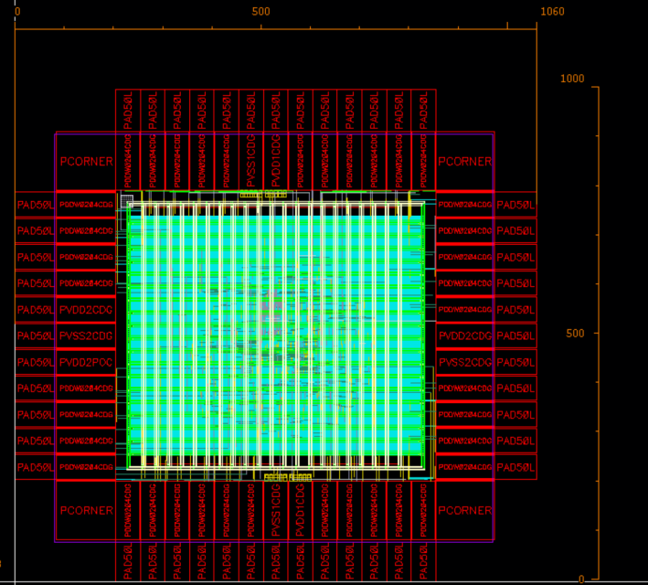
Physical design – Add bond pads
Total size: Width:1060[um] Height: 1000 [um]

Slide 30
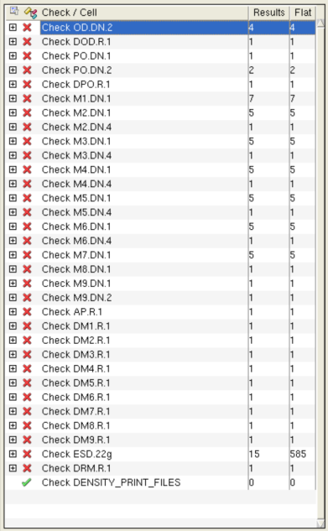
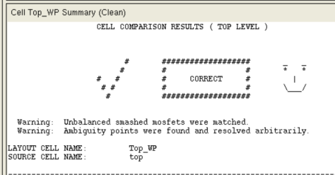
Physical design – Physical Design Verification
Passed LVS and DRC

Slide 31
Milestones Ahead
Preliminary GDS Submission (20.07.25)
Tapeout deadline (20.8.25)

Slide 32
THANK YOU!

